Slide 1
Joint Coordinating Committee for Radiation Effects Research Radiation Dose Reconstruction for the Techa River and Mayak Worker Cohorts
Bruce Napier, Michael Smith; PNNL
Marina Degteva; URCRM
Alexander Efimov; SUBI

Slide 2
Brief Historical Background
The Mayak plutonium facility began operating in 1948, in the Southern Urals, Russia.
Worker exposures in the early years were VERY high.
Waste-storage failures resulted in several releases of uranium fission products (⁹⁰Sr, ⁸⁹Sr, ¹³⁷Cs, ⁹⁵Zr, ⁹⁵Nb, ¹⁴⁴Ce, ¹⁰⁶Ru, ¹³¹I, etc.) into the environment:
1949-1956: 1.15×10¹⁷ Bq of liquid wastes were released into the Techa River;
1957: 7.4×10¹⁶ Bq were accidentally discharged into the atmosphere by a tank explosion which formed the East Urals Radioactive Trace (EURT);
1967: 2.2×10¹⁴ Bq were windblown from Lake Karachay (an open repository of radioactive waste).

Slide 3
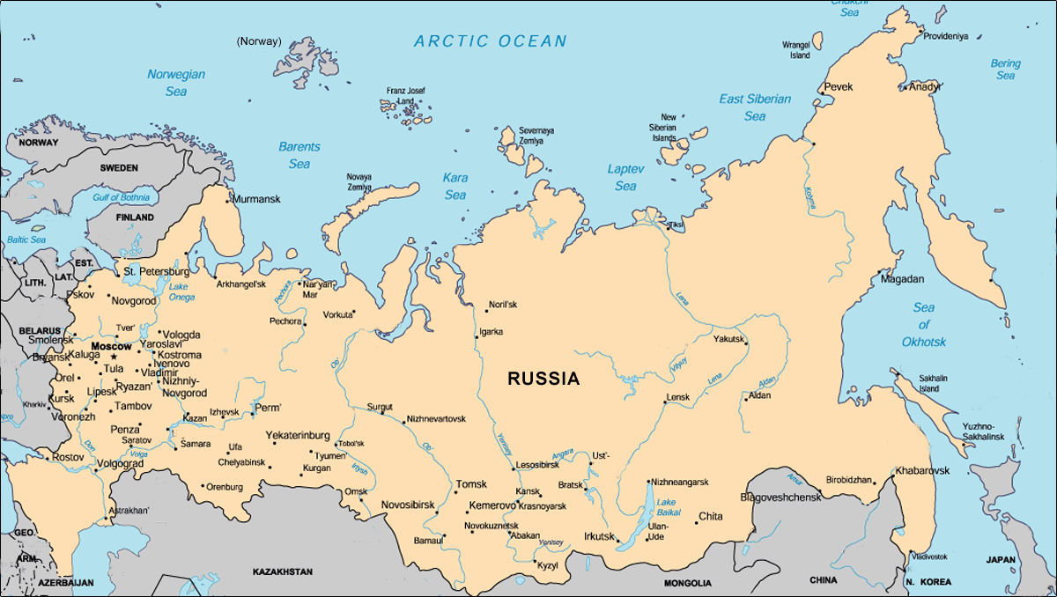
Background Location of Mayak
Mayak
Adapted from Bradley, Donald J. Behind the Nuclear Curtain: Radioactive Waste Management in the Former Soviet Union. Battelle Press, Columbus, OH (1997)
Notes:
55 degrees 45 min North

Slide 4
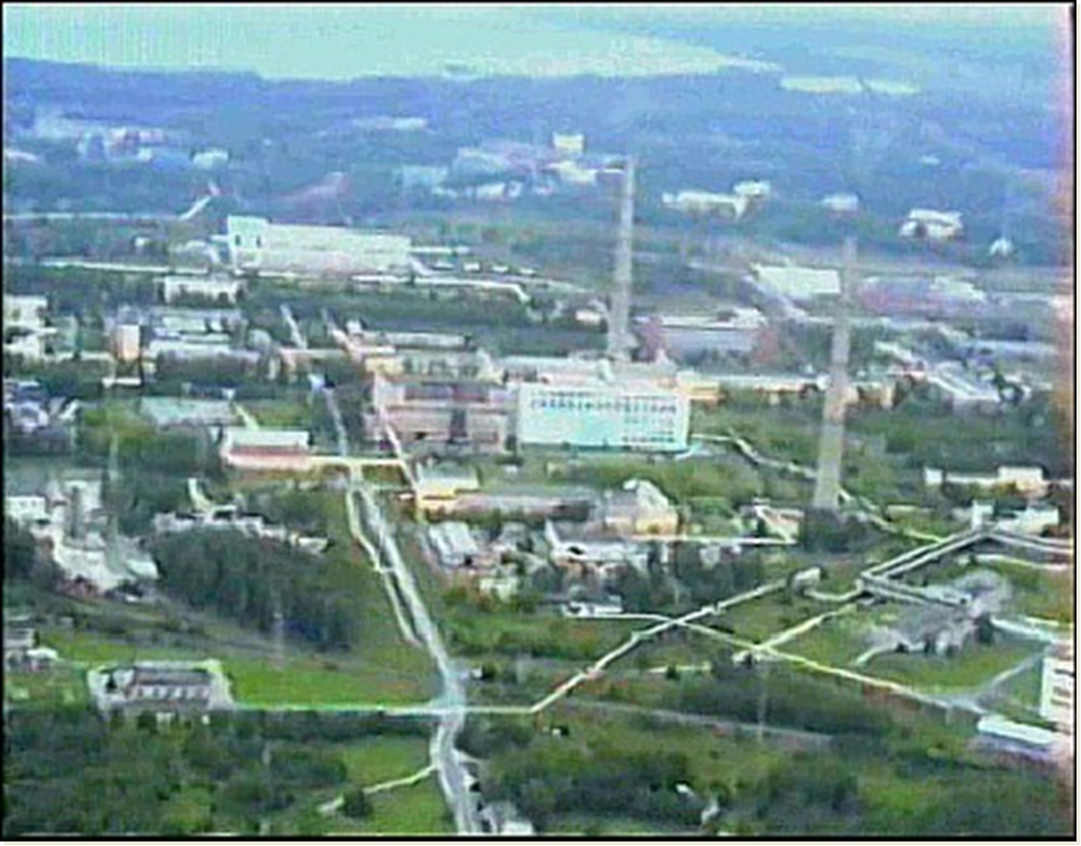
View of Mayak Complex

Slide 5
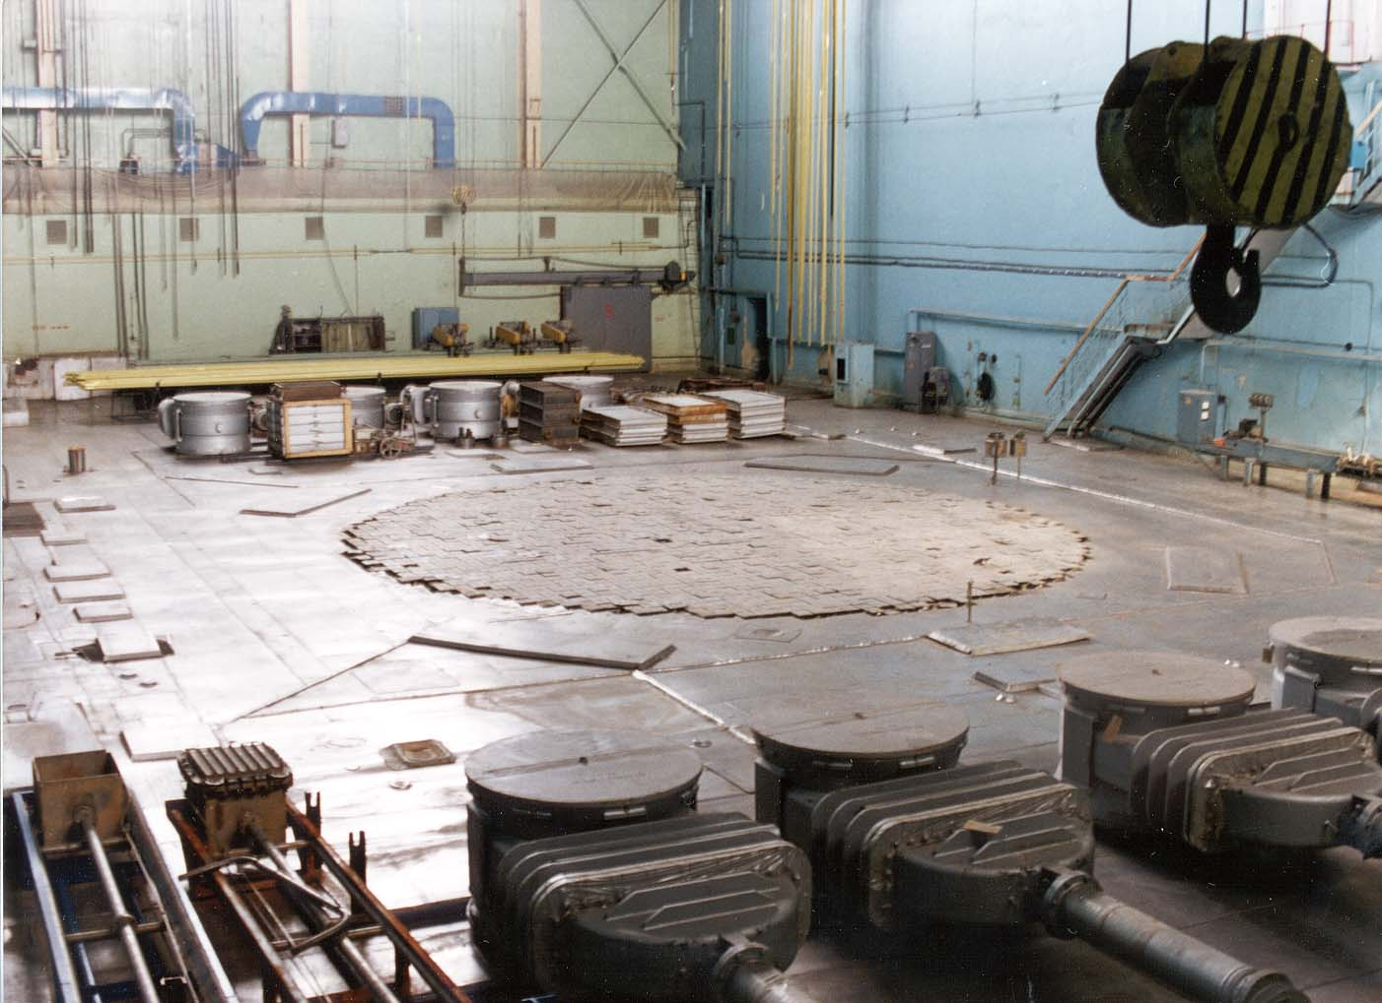
A-reactor: Mayak’s first

Slide 6
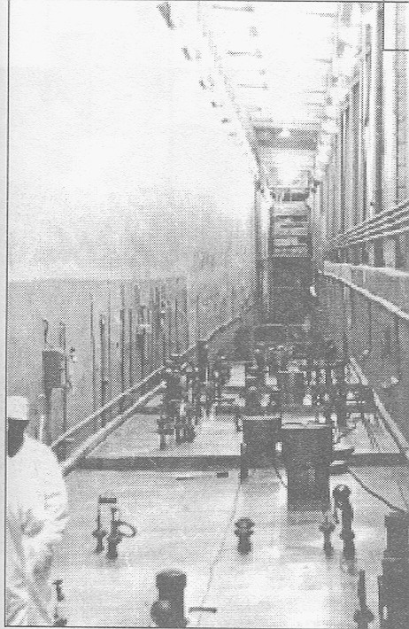
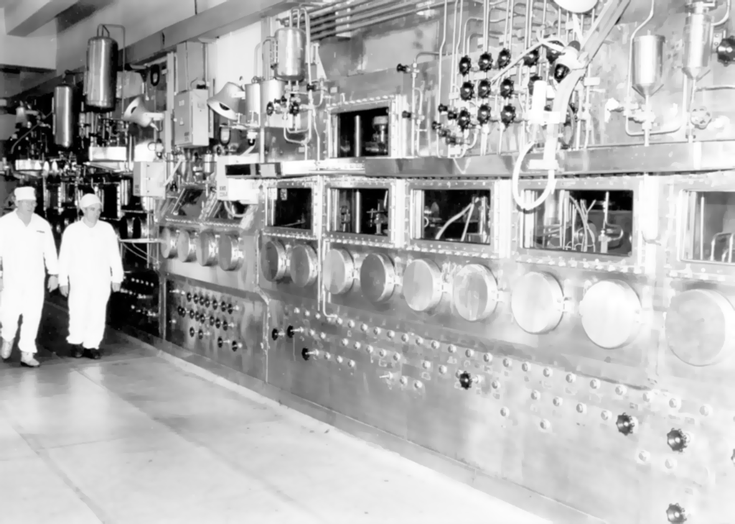
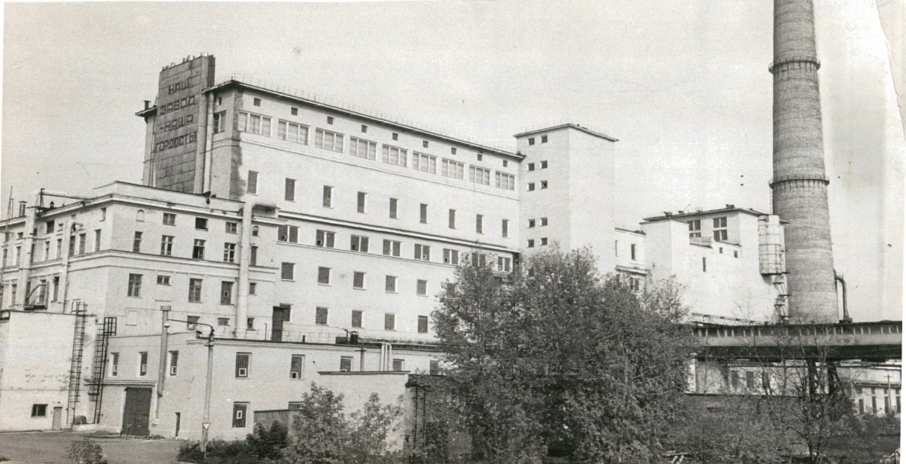
Radiochemical Plant

Slide 7
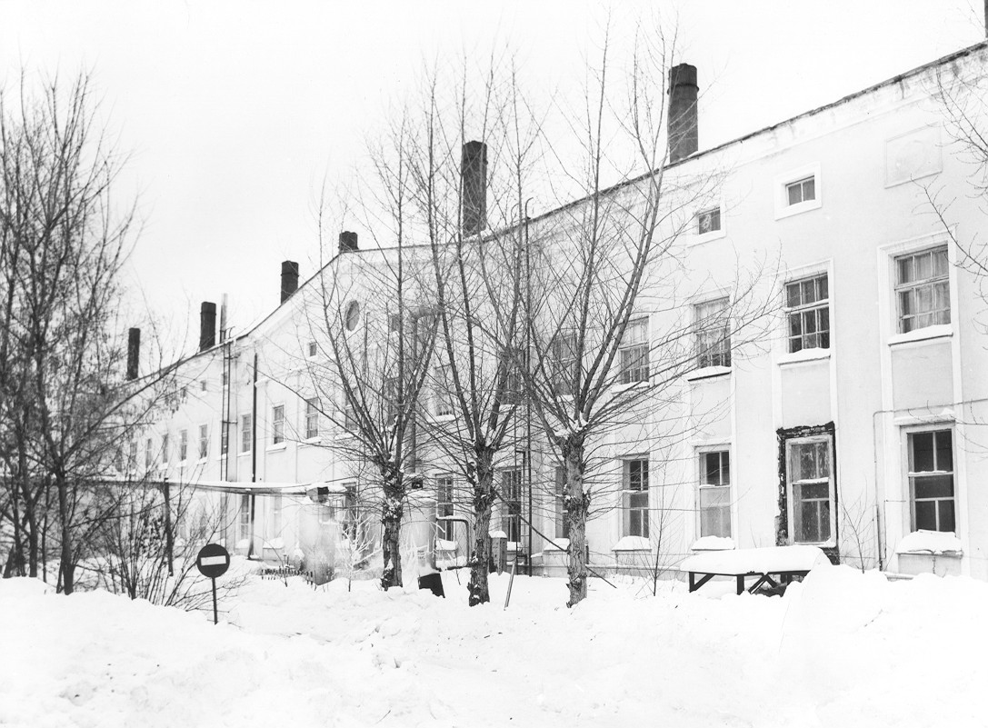
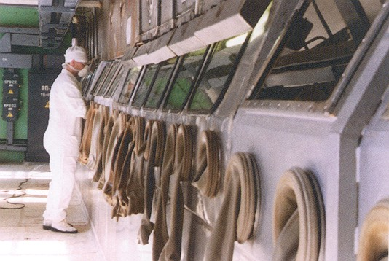
Plutonium Plant

Slide 8
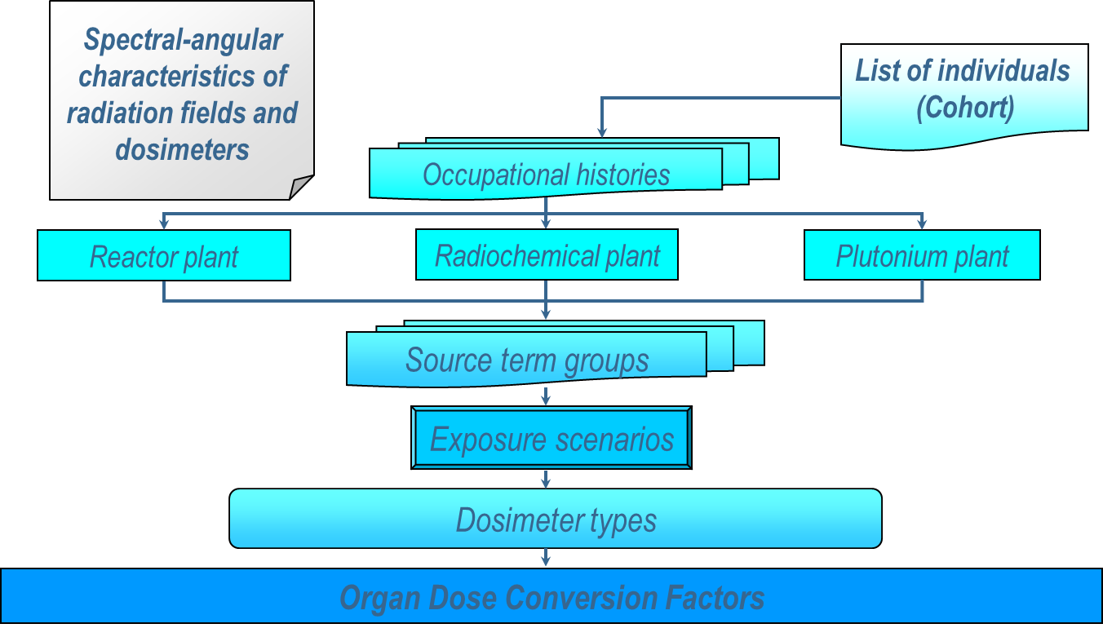
Mayak Workers – External Dosimetry
Based primarily on extensive film badge records
84% workers - Archive Dose
16% workers – Coworker
Exposure Scenarios
Source term
Exposure Geometry
Transport Calculations

Slide 9
MWDS External Doses are Large, Decrease with Time

Slide 10
Mayak Workers – Internal Dosimetry
8,043 workers monitored for intakes via urinalysis
~1,240 worker autopsy cases are available; ~500 of these also have earlier urinalysis bioassay
Project 2.4 used these data to develop rate constants for the lung and systemic biokinetic models
Collaborative work with SOLO and U.S. Transuranium and Uranium Registries has demonstrated a bound fraction of inhaled Pu material
Impact of DTPA administration taken into account
Addition of americium component of dose underway
2-Dimensional Monte-Carlo Bayesian model used for reconstruction of internal doses – the PANDORA code

Slide 11
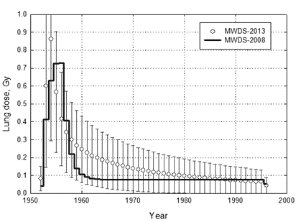
MWDS-2016 Doses from Internal Sources
Monitored Mayak Worker Cohort of 8043 Workers
Organ | Median, mGy | Mean, mGy | Maximum, mGy
Bone surface cells | 108 | 707 | 46,600
Liver | 27 | 177 | 11,300
Lung (weighted sum) | 31 | 185 | 8,980
A typical internal dose history
Improved lung model

Slide 12
Job Exposure Matrix
Objective: Take the internal dosimetry information from monitored workers and propagate it to unmonitored workers employed at similar workplaces and periods of time
Use computed plutonium intakes for each monitored worker as the starting data
Select an intake from the distribution of worker intakes
Associated shared parameters will be saved to enable the forward calculation of dose for the unmonitored workers
The output will be dose distributions in a format equivalent to those for monitored workers
Will allow addition of many more workers and worker-years to epidemiological analyses

Slide 13
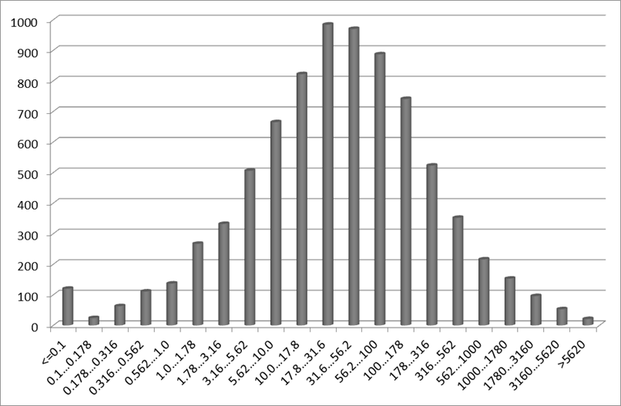
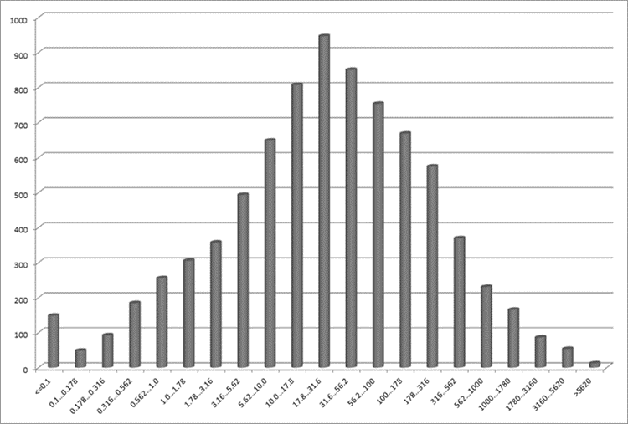
MWDS-2016 Doses
Population Distribution of
Weighted Lung Dose, mGy
Population Distribution of
Liver Dose, mGy

Slide 14
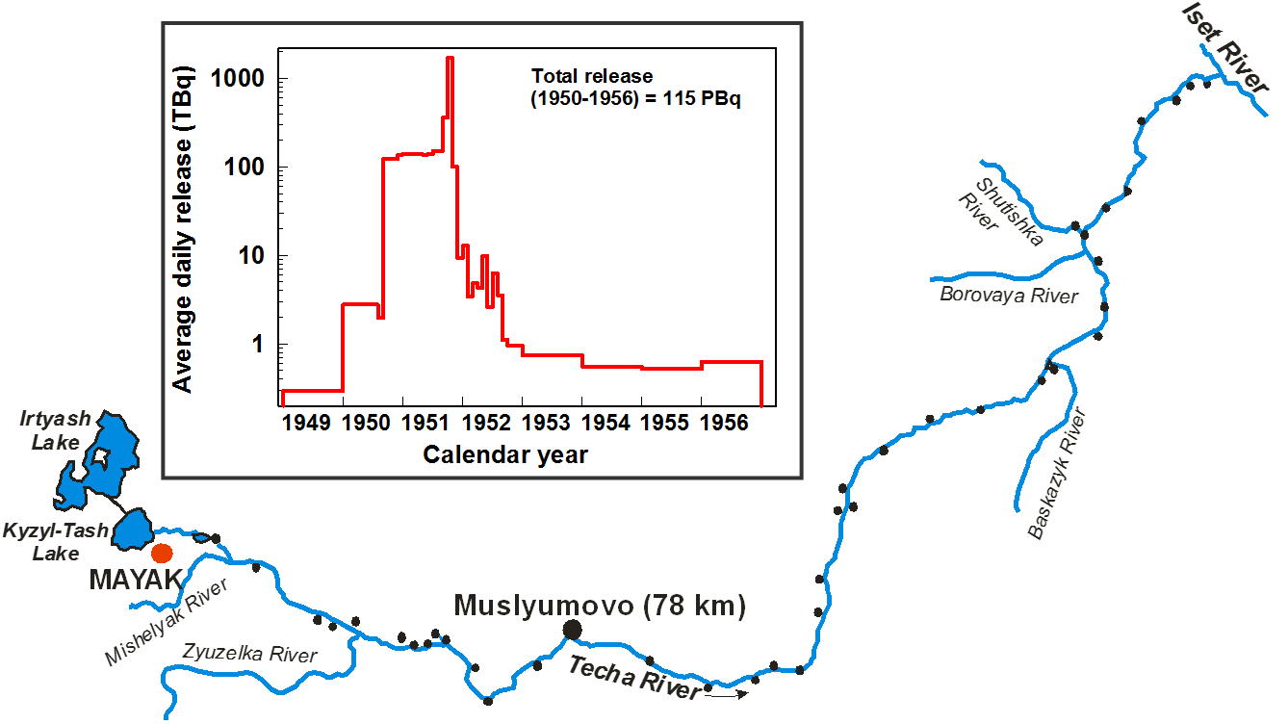
Releases into the Techa River
Chronic Exposure to 30,000 Individuals Living in Downstream Villages
Degteva MO, NB Shagina, MI Vorobiova, LR Anspaugh, BA Napier.
REEVALUATION OF WATERBORNE RELEASES OF
RADIOACTIVE MATERIALS FROM THE MAYAK PRODUCTION
ASSOCIATION INTO THE TECHA RIVER IN 1949-1951.
Health Physics 102(1):25 - 38.

Slide 15
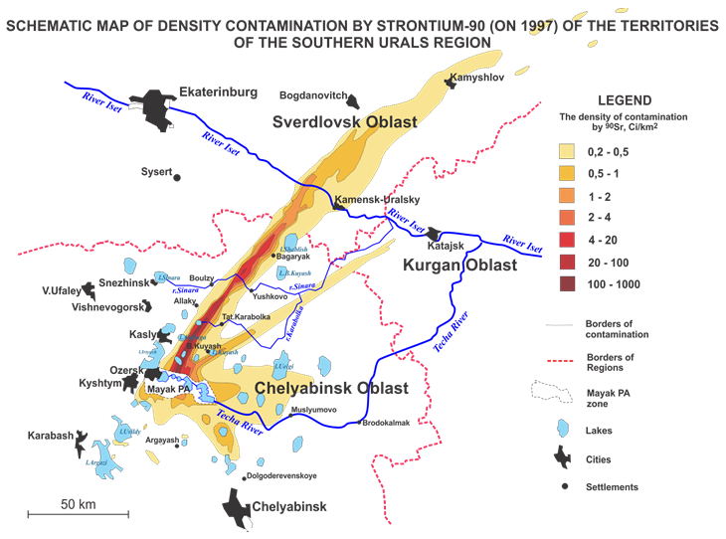
Features of the Mayak Region

Slide 16
Routes of Radiation Exposure for the Techa River and EURT Cohorts
Internal exposure due to drinking water drawn from the river and consumption of foods contaminated by river water and fallout;
External exposure from the contaminated flood-plain soils and fallout.
The Techa River Dosimetry System (TRDS) was created to support epidemiological studies using individual dose estimates.

Slide 17
Techa River Dosimetry System (TRDS)
The TRDS has been developed to provide estimates of internal and external doses for the Techa Riverside villagers.
The reconstruction of internal doses from intake of radionuclides is based primarily on a large number of measurements of radionuclide burden in humans.
The traditional approach of analyzing all steps of the pathway of exposure is only used as a backup when other approaches have been exhausted.
This methodology is rather unique in the worldwide practice of environmental dose reconstruction.

Slide 18
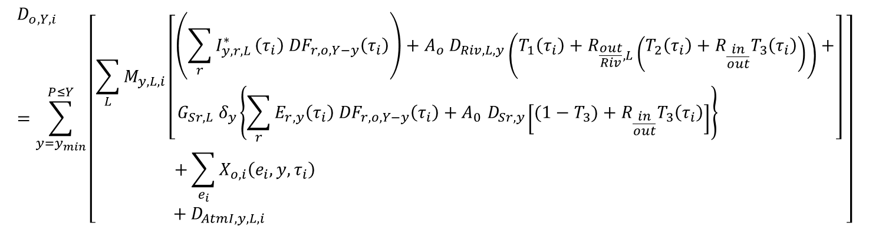
TRDS Includes 6 Sources of Radiation Exposure
External and internal exposure on the Techa River
External and internal exposure on the EURT area
Medical exposure at the URCRM clinics
Atmospheric iodine pathways

Slide 19
Measurements of ⁹⁰Sr in Techa River Residents
Dataset | Period of Measurements | Number of People* | Number of Measurements
Postmortem measurements of ⁹⁰Sr in bones | 1951-1989 | 240 | 1,100
In vivo measurements of ⁹⁰Sr in front teeth with tooth beta counter (TBC) | 1959-1997 | 11,000 | 23,000
In vivo measurements of ⁹⁰Sr in body with whole body counter (WBC) | 1974-1997 2009-present | 12,200 2,200 | 28,000 2,800
* Lived in Techa Riverside settlements at any time in the period 1950-1960

Slide 20
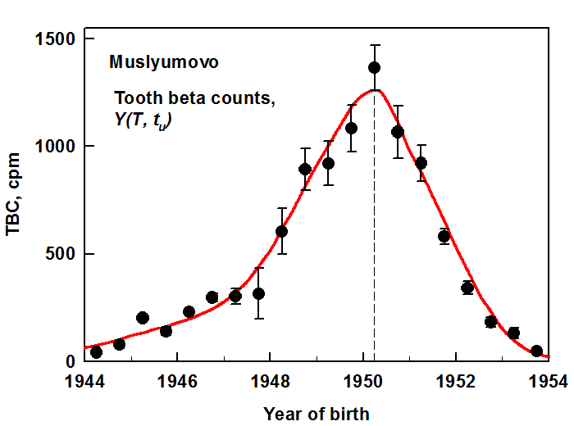
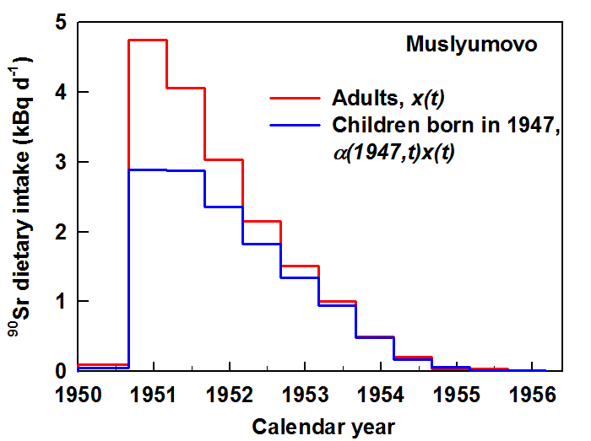
Reference ⁹⁰Sr Intake Function
Evaluated using tooth beta counter data
Tolstykh EI, Degteva MO, Peremyslova LM, Shagina NB, Shishkina EA, Krivoschapov VA, Anspaugh LR, Napier BA.
Reconstruction of long-lived radionuclide intakes for Techa riverside residents: Strontium-90. Health Phys 101(1):28–47; 2011.

Slide 21
Organ Doses from External Exposure
Derived from dose rate in air on the Techa River banks and in villages – measured and calculated
Individual doses were calculated in accordance with historical records of individuals’ residence histories
Observational data of typical lifestyles for different age groups
Age-dependent conversion factors from air kerma to organ dose

Slide 22
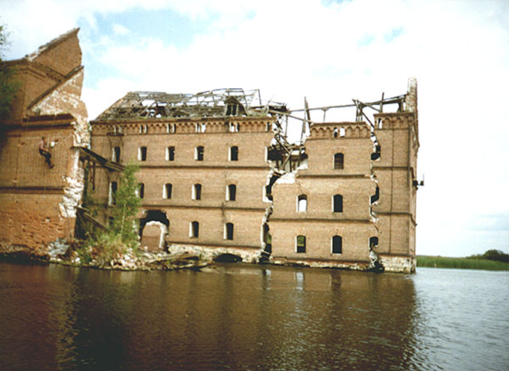
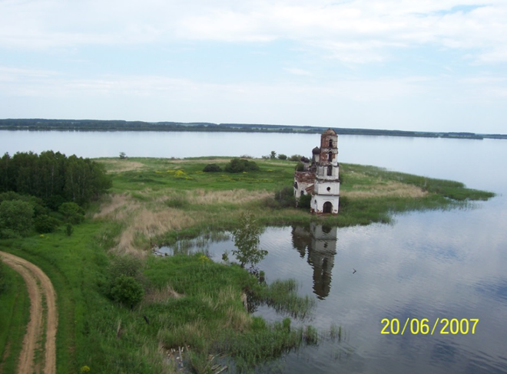
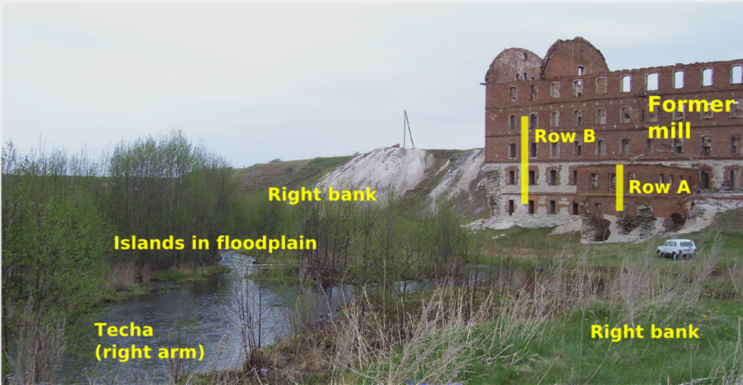
External Dose Rates Were Validated with TL/OSL Measurements
Metlino
Church
Metlino Mill
Muslyumovo Mill

Slide 23
External Dose Estimates for Individuals Validated Using EPR and FISH
Expected doses in the upper Techa Riverside residents exceed the detection limits for EPR (100 mGy) and FISH (300 mGy)
EPR and FISH measurements were corrected for ⁹⁰Sr contribution to tooth enamel dose and bone dose
EPR and FISH-based dose estimates are comparable to TRDS
Cluster/Settlements | Distance from the release site, km | Number of FISH donors | FISH-based dose, mGy | Number of EPR donors | EPR-based dose, mGy
Metlino | 7 | 23 | 510±72 | 11 | 547±170
Asanovo, Techa-Brod, M Taskino, Gerasimovka | 18-45 | 13 | 390±102 | 24 | 223±83
Nadyrov Most, Dadyrovo | 48-50 | 12 | 480±102 | 10 | 569±250
Ibragimovo, lseavo, PHT | 54-70 | 23 | 130±75 | 34 | 160±60
Degteva et al. Analysis of EPR and FISH studies of radiation doses in persons who lived in the upper reaches of the Techa River, Radiat Environ Biophys 54:433–444 (2015)

Slide 24
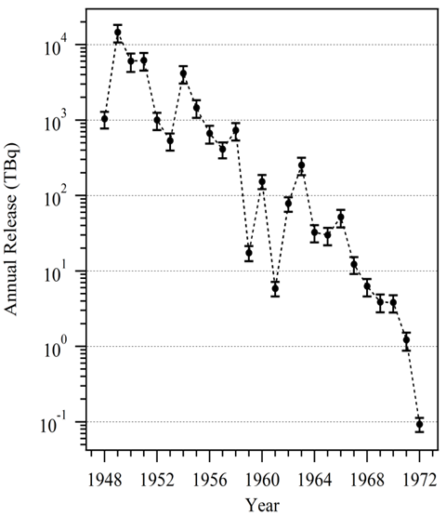
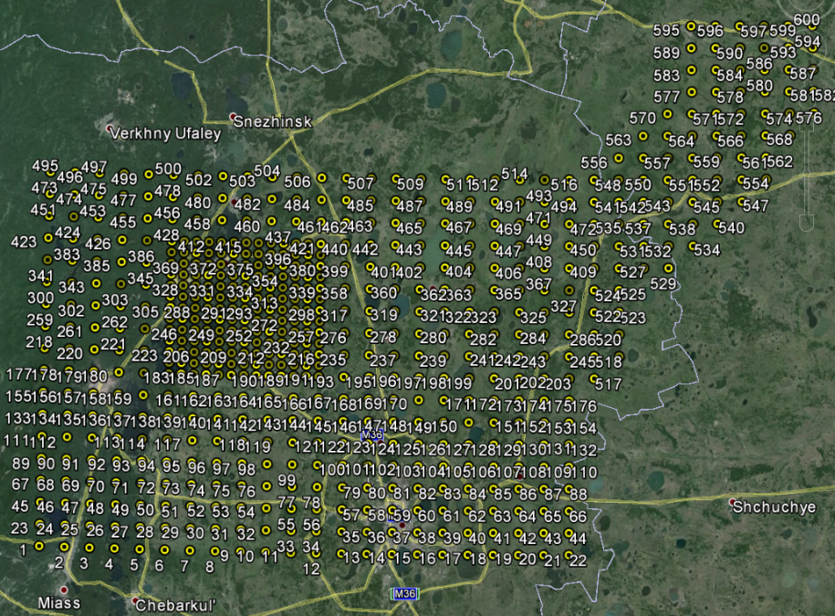
I-131 Dose Estimation
Source term from Project 1.4
Atmospheric dispersion approximated using 2007-2011 hourly results
Napier BA, PW Eslinger, EI Tolstykh, MI Vorobiova, EE Tokareva, BN Akhramenko, VA Krivoschapov, and MO Degteva. 2016. Calculations of individual doses for Techa River Cohort members exposed to atmospheric radioiodine from Mayak releases. Submitted to Journal of Environmental Radioactivity

Slide 25
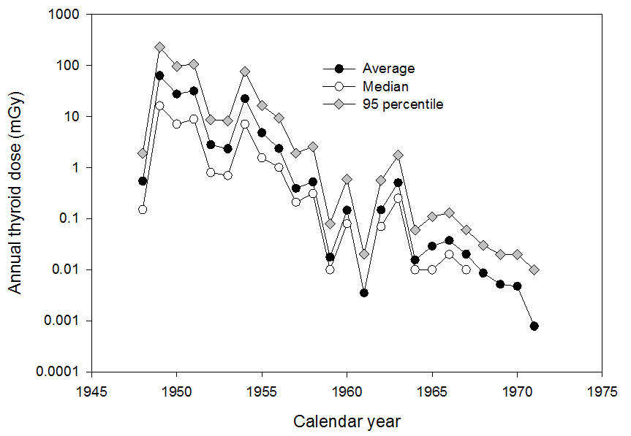
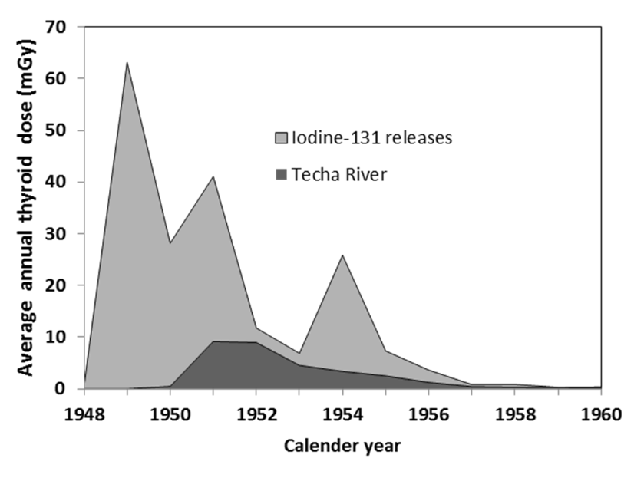
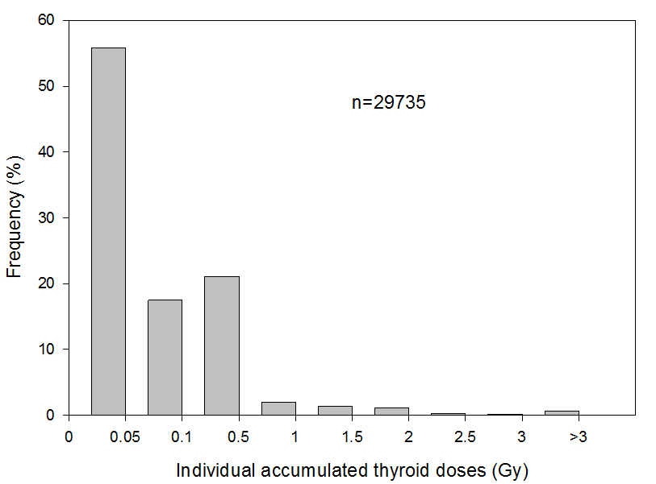
I-131 Doses
Calculated with tool developed for JCCRER Project 1.4
Annual Cumulative Thyroid Dose
Mean 193 mGy
3% >1 Gy (youngsters near Ozersk)

Slide 26
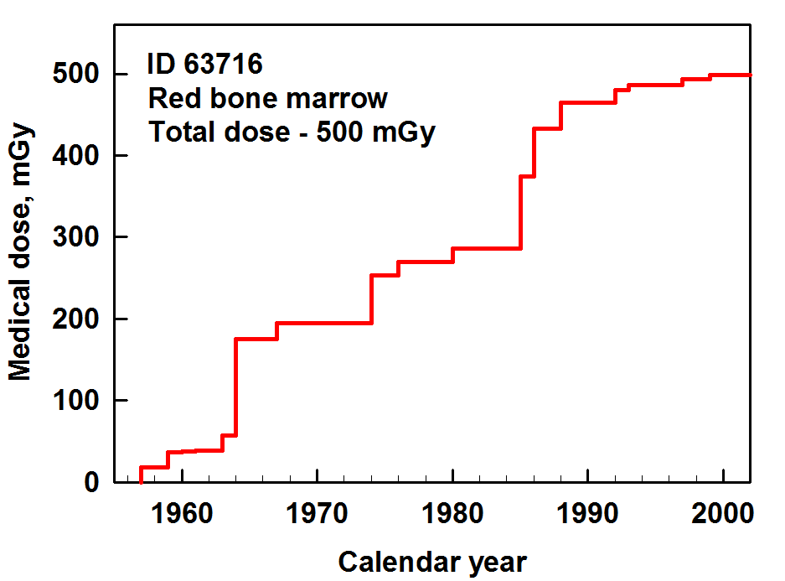
Mayak and Techa Include Medical Exposures
Procedures Book
Procedures per Patient as f(t)
Patient
Cards
Medical Exposure Doses
Historic
Data
Dose per Unit Procedure as f(t)
Current
Evaluations
Example: This woman was examined at the URCRM clinics 39 times in 1957-2001.

Slide 27
Estimation of Uncertainty by the JCCRER Projects
All individual doses are being estimated with uncertainties
Uncertainty estimates:
Consider shared uncertainties
Consider unshared uncertainties
Consider Berkson and Classical error types
Consider individual autocorrelations
Are saved for epi studies as complete correlated cohort files
Napier BA, MO Degteva, NB Shagina, and LR Anspaugh. 2013. Uncertainty Analysis for the Techa River Dosimetry System. Meditsinskaya Radiologiya i Radiatsionnaya Bezopasnost 58(1):5-28

Slide 28
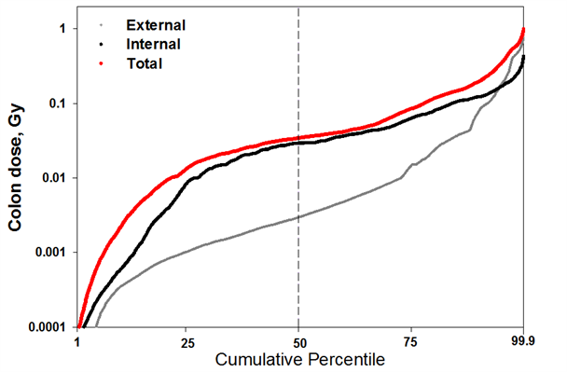
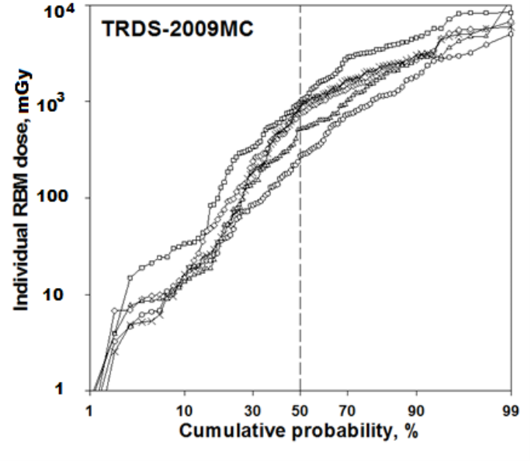
Uncertainty in 30,000 Techa River Cohort Member Doses
Deterministic Estimates Calculated Used TRDS-2016 D
5 Realizations (from 1500) Generated by Stochastic TRDS-MC

Slide 29
JCCRER Doses
Collection of data and development of models and methods is ongoing
Updated calculations have been provided
The methods and results have international impact:
Methods-
have been addressed in an upcoming US NCRP report on dosimetry for the Million Radiation Worker Study
have been supplemented by substantial efforts from the European Union
Results are incorporated in a recent report on low-dose-rate effects by UNSCEAR

Slide 30
Points for Now and Later
For now
These are some of the best cohorts since the Life Span Study; with protracted internal and external exposure
Both Techa and Mayak cohorts are low-dose RATE
Techa can be considered to be largely a low-dose group (although most of the ‘information’ comes from the higher doses)
There are uncertainties, but they are not insurmountable
For later
Effects per unit dose internal and external appear to be the same:
this validates the ICRP Effective Dose paradigm
It impacts discussions of DDREF
Epidemiology will never resolve issues in the >1 mSv range, but LNT is a good operational tool
Emphasize how FEW cases of illness related to radiation that we see in these extremely-exposed cohorts

